Slide 1
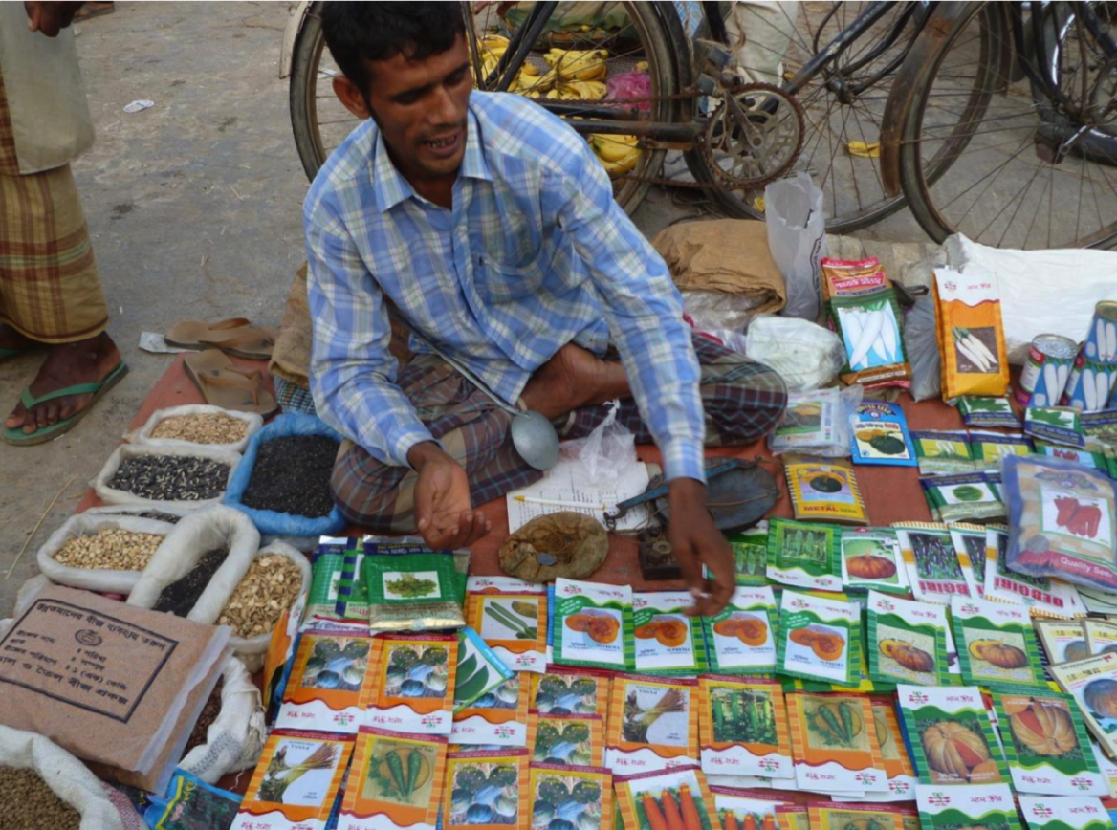





Seeds of
change
Bangladesh
Interventions
Innovations in seed packaging, access to critical information
via mobile seed vendors
System Change
Poor farmers’ access to quality seeds becomes the new normal
Impact
Income and nutritional benefits for millions living in rural poverty
How Katalyst enabled half a million small farmers to step up vegetable production
Notes:
This presentation tells the story of one successful initiative by the Katalyst programme in Bangaldesh, between 2008 and 2013.
This initiative, to overcome last-mile distribution hurdles, enabled at least half a million small-holder farmers (mostly women) to step up vegetable production.
It involved innovations in seed packaging and access to critical information via mobile seed vendors, driven by engagement with seed supplier companies.
These changes were taken up at such a large scale that access to quality seeds, and good advice about how to use them, become the ‘new normal’ for Bangaldeshi vegetable farmers. As a result, we estimate this initiative led to income and nutritional benefits for millions of people living in rural poverty.

Slide 2




A market system approach to the issues
Why vegetable farming?
A vital source of food & supplementary income for 4 million poor rural households
The missed opportunity
Growing urban demand; but farmers (esp. women) held back by low yields & risks of crop failure
System diagnosis
Risks exacerbated by limited access to quality seeds & reliable information on how to use them
Root
causes
Seed suppliers unaware of opportunity, and
fail to invest in distribution innovations
Notes:
A market system approach to the issues facing vegetable farmers
Katalyst chose to work on issues in vegetable production for two reasons:
First, because in 2008, vegetable production was already an important source of food and supplementary income for four million rural households (including a least a million where women were the main cultivators).
Secondly because it was apparent that smaller farmers were missing out on the opportunity to increase their incomes through supplying vegetables to rapidly growing urban markets. Increased production would also have wider nutritional benefits.
Traditionally, farmers with little land only grew vegetables on micro-plots for own consumption (homestead gardening). Women in particular did not go to markets to buy inputs or sell produce. This meant they had little access to information and advice about quality vegetable seeds and how to use them.
In 2008 Ministry of Agriculture (MoA) estimated that less than one-in-five farmers were using reliable high-yielding vegetable seed varieties. As a result, few were able to take advantage of growing demand for vegetables in urban areas where increased prosperity is changing food habits.
Katalyst’s analysis of the market system for vegetable seed revealed that quality seed distributors and retailers were only established in towns and major markets. Smaller and more remote farmers and homestead gardeners instead buy from itinerant mobile seed vendors in small local markets or at the farm gate. They mostly sold inferior, unpacked seed (less likely to germinate, more disease prone and with lower yields). In addition, those poor farmers knowledgeable enough to seek out quality seeds found that regular sized seed packets were far too large for their small-scale cultivation needs.
Few (ten out of 100 large firms) had a good reputation for supplying quality seeds. Those that did focused their marketing efforts on larger, commercial farmers in the established vegetable production districts. The underlying reason for this was a failure to recognise the potential of smaller farmers as reliable customers, and an unwillingness to take risks to recruit them. Hence no strategy or investment plan to reach them.

Slide 3
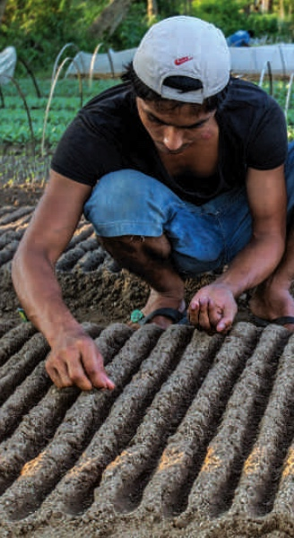

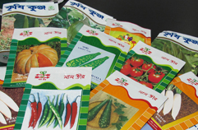
MSD interventions that catalysed innovation & behaviour change
Integration of mobile seed vendors
Seed suppliers offered incentives for informal vendors,
to draw them into a formal distribution system
Formalising training for vendors
Suppliers trained vendors to provide technical information to poor farmers
Seed package innovation
Tamper-proof mini-packs assured farmers
of high quality seeds at a price they can afford
Notes:
Katalyst developed a vision for lasting change with widespread impact. It centred on engaging the major seed supply companies to develop a better system for distributing good quality seeds to small farmers and homestead gardeners.
This required three significant business innovations, launched through various partnerships that evolved between 2009 and 2012 as Katalyst learned more about the seed market system.
1. Integration of mobile seed vendors
In order to get seed suppliers on board, Katalyst needed to demonstrate that smaller farmers could become valuable customers without huge investments in marketing.
Its first important deal in 2009 was with a large reputable seed company. Lal Teer Seeds agreed to incorporate mobile vendors into their formal distribution channels, by offering them discounted prices. Katalyst covered a proportion of the business risk.
2. Formalising training for vendors
Katalyst knew that good yields for farmers required access to reliable information as well as seeds. It designed and arranged initial training for the first group of 50 mobile seed vendors. As their success in reaching new customers (5,000 within 2 years) became obvious, Lal Teer took on full responsibility for training new groups. They were quickly copied by other seed companies.
3. Seed pack innovation
Conventional packs (typically containing seed for 1000 m²) are too large for small farmers. Vendors would open packets and re-sell contents in smaller quantities. This was bad for assuring seed quality and threatened brand reputation.
In 2010 Katalyst partnered with two companies (Lal Teer and A R Mallik) to design, develop and test tamper-proof mini-packs (containing enough seed for just 150 m²). The companies made 35 varieties of hybrid and open pollinated quality-assured seeds affordable to poor farmers. Katalyst helped develop attractive packaging and promotional materials.

Slide 4







How MSD interventions led to system change & impact
Katalyst’s
market research convinced seed suppliers that the smallholder market was large enough to justify their investment in innovation
Katalyst supported pilots proved mobile vendors were an effective way to reach smaller farmers with quality seeds and information
Mobile vendors selling mini-packed seeds along with better advice led to huge increases in sales to small farmers. Other agri-input firms copied the model
Larger & more reliable yields convinced many other small farmers to invest more, step up cultivation and achieve higher incomes
Notes:
How MSD interventions led to systemic change and impact
Katalyst’s theory of change in this MSD approach involved the following logic:
Katalyst’s market research and negotiations convinced at least one major seed supplier that the smallholder market had enough potential to justify their investment in distribution innovation.
Support for training and inclusion of mobile vendors in formal distribution channels proved an effective way to reach smaller farmers with quality seeds and information. Other companies started to adopt this vendor model. Then Katalyst helped companies introduce mini-packs for seeds to make them more relevant and affordable to smaller farmers, especially women.
Sales to small farmers soared thanks to availability of mini-packed seeds along with better advice from trained mobile vendors. Other agri-input firms adopted the mini-pack technology.
Better yields and higher returns achieved by early adopters of mini-packed seeds convinced increasingly large numbers of small farmers to step up vegetable cultivation and invest more to achieve higher incomes.

Slide 5



Signs of lasting market system change
Mini-packed seeds became hugely popular
750,000 mini-packs sold within two seasons
Half a million households using mini-packs across
85% of the country
````
US$ 14m est. increase
in value of vegetable production in 18 months
80% of vendors’ customers
are people living in poverty
Poor farmers’ incomes increased
Companies took ownership of
training vendors
1000 vendors trained
by Katalyst’s main partner
Est. 4,500 vendors trained
by copying companies
Mini-packs & informed vendors the ‘new normal’
More training centres established by other agri-input businesses
Better access to reliable information on crop
production & protection.
Notes:
Mini-packed seeds became hugely popular
Sales of mini-packed seeds far exceeded seed company’s expectations.
Three quarters of a million were sold in the first year (200,000 in early season, 550,000 in late season).
Mini-packs were being distributed across 55 (out of 64) districts within two years.
By 2012, the total number of households using mini-packed seeds had grown to 460,000.
Poor farmers’ incomes increased
A comparative study of 500 farmers using / not using quality seeds over 3 seasons showed that:
80% of households buying mini-packed seeds were living in poverty (<USD 2.5/day)
Incomes of individual farmers rose by USD 17 per season on average, and 90% had nutritional benefits from increased consumption of vegetables
Aggregate income of poor farmers increased by USD 14 million in just 18 months
Companies took ownership of the training function
Lal Teer invested in training more than 1,000 vendors to reach farmers in remote locations such as small riverine islands called chars.
This led other companies to following suit. They started adopting strategies to produce, package, and market vegetable seed mini-packet (including poaching competitors’ staff)
By 2018, it is estimated 4,500 mobile vendors were part of seed companies’ distribution networks (reaching over half a million farmers).
Mini-packs and informed vendors are the new normal
The Katalyst-inspired ‘last-mile’ distribution model is now mainstream in Bangladesh. Companies are using the same formula to make other agro-inputs accessible to small and remote farmers (e.g. crop protection)
It has also become ‘normal’ for companies to invest in training small retailers (including in remote locations). Syngenta branched out to set up a rural training centre to train their distributors and retailers. Hundreds of thousands of farmers have benefitted from retailers becoming a more reliable source of knowledge on disease control.

Slide 6


Katalyst (Phase II) in context
A multi-sectoral MSD programme funded by DFID, SDC, CIDA & the Netherlands.
Economic sectors
  Vegetables, maize, potatoes, jute, fisheries, agri-inputs, furniture, ICTs.
Budget
  $ 53m over five years (2008 – 2013)
Impact
  Estimated benefits for 2.3m farmers
  & small businesses
  Income increases of US$ 296 m
Notes:
Background to the programme
Katalyst was one of first MSD programmes to translate the ‘making markets work for the poor’ concept into a functional approach. By its end it had increased the income of millions of poor women and men in rural and urban areas of Bangladesh.
Katalyst pioneered a flat organisational structure in which young business graduates work together to analyse market dynamics and work out new business models. It advocated a strong entrepreneurial ethos - to grasp pro-poor market opportunities as they occur instead of sticking to a planned delivery model.
Due to its success. Katalyst was implemented for three consecutive phases:
Phase I 2003 - 2008
Budget: CHF 26 million (approximately USD 27 million at 2018 rates)
Funders: Swiss Agency for Development and Cooperation (SDC), United Kingdom’s Department for International Development (DFID) and Swedish International Development Cooperation Agency (SIDA)
Implementers: by Swisscontact and GIZ International Services
Achievements:
helped create around 200,000 full-time equivalent jobs
benefited 700,000 farmers and small businesses, by increasing their access to better:
services, technology, inputs, representation
Phase II 2008 - 2013
Built on the success of Phase I to reach more poor women and men by using the market development approach, but added a stronger focus on mitigating environmental, social and gender-related issues.
Budget: CHF 51 million (approximately USD 53 million USD at 2018 rates)
Funders: SDC, DFID, Canadian International Development Agency (CIDA), Embassy of the Kingdom of the Netherlands (EKN)
Implementer: Swisscontact
Achievements:
impacted around 2.36 million farmers and small businesses
increased their income by around USD 295 million.
Phase III 2013 - 2018
In Phase III Katalyst built on Phase II to further expand its outreach. It also focused on sharing what it had learnt with the private and public sector.
Budget: CHF 32 million (approximately USD 32 million at 2018 rates)
Funders: SDC, DFID and Danish International Development Agency (DANIDA)
Implementer: Swisscontact
Achievements (results of all 3 phases):
benefited 4.75 million farmers and small businesses
beneficiaries see an income increase of USD 724 million

