Slide 1
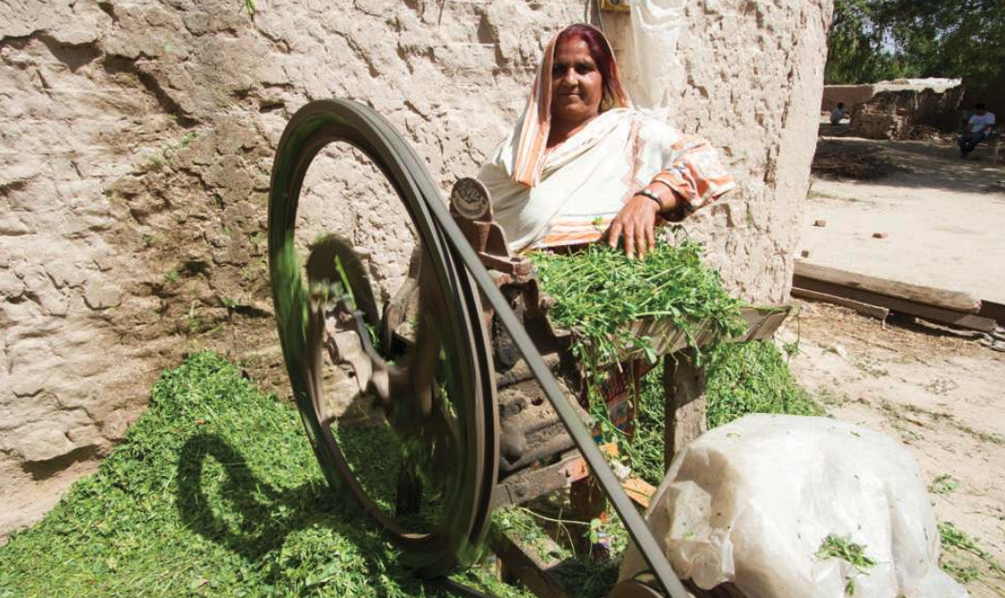





Fodder for the future
Pakistan
Interventions
Technical & financial innovations for small-scale silage businesses
to produce year-round fodder
System Change
Emergence of a new layer of
services and investment that
support smaller livestock farms
How MDF kick-started a leap in the productivity of 40,000 small-scale livestock farms
Impact
Increased and more stable income from livestock farming for 40,000 rural households
Notes:
This presentation tells the story of one successful initiative by the MDF programme in Pakistan, between 2011 and 2017.

Slide 2




A market system approach to the issues
Why livestock farming?
A source of income and food security for six million farmers, hampered by very low productivity due to lack of dry-season fodder
The missed opportunity
Growing urban demand for meat, and potential to substitute imports of dairy products, should spur investment to make fodder available in dry season
System diagnosis
Previous silage promotion efforts reflected the perceptions and interests of commercial firms and only met the needs of large-scale farms
Root
causes
Lack of awareness of, or confidence in, the viability of technology, financial products & services geared to meeting needs of smallholders

Slide 3
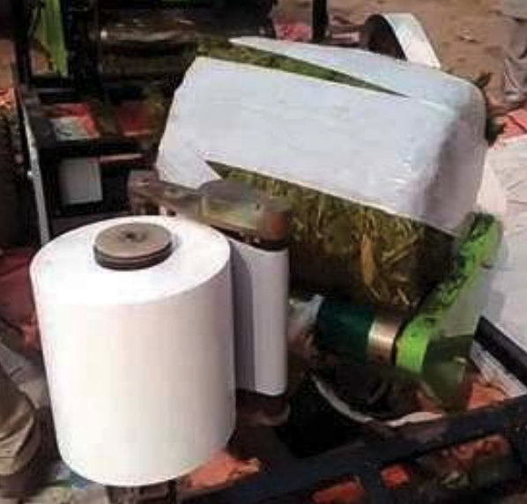

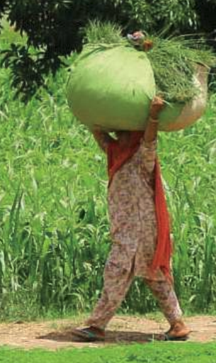
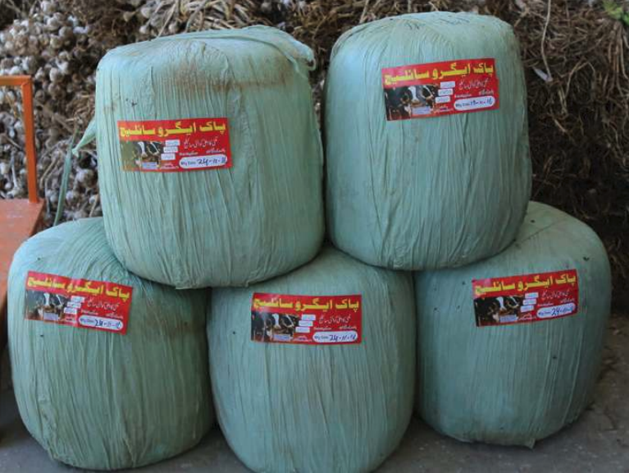
MSD interventions that catalysed innovation & behaviour change
Test technology & viability of silage business
MDF co-invested with small-scale entrepreneurs to purchase silage balers, related machinery and pioneer the marketing of fodder in small bales
Financial innovation to stimulate investment
MDF engineered a novel three-party agreement
between bank, equipment supplier and entrepreneurs that helped de-risk loans for silage-producing businesses
Kick-start rental for silage-related machinery
MDF worked with equipment supplier to confirm viability of rental services to enable rapid growth in supply of silage

Slide 4







How MSD interventions led to system change & impact
MDF’s partnerships with silage entrepreneurs, bank & machinery suppliers demonstrated that small-scale silage production is a viable technology & business
Success of initial businesses & machinery rental services led to further growth in fodder supply, with crowding-in by other silage entrepreneurs
Affordable access to year-round fodder enabled farmers to improve animal health, increase productivity and maintain dairy output all year
Farmers were able to expand their herds and raise their household incomes from increased sales of milk & meat

Slide 5




Signs of lasting market system change
Silage producers are successful businesses
Over 100 small bale silage producers established by 2017 (incl. many run by women)
Approximately 300 new full time jobs created in silage production
Supplementary feeding has become widespread
40,000 extra farmers using supplementary fodder by 2017
Doubled acreage of maize grown for silage, incl. under contract
Major benefits realised for livestock farmers
````
Average milk yields doubled, with associated increases in household income
2 hours less manual labour each day for women keeping livestock
Equipment suppliers are importing a wider range
of products & innovating their financial offers
Farmers now investing more in animal welfare e.g. nutritional products & health treatments
Increased investment in related activities

Slide 6



Market Development Facility (MDF) Phase 1 in context
First phase of a multi-country MSD programme of Australia’s
Dept. for Foreign Affairs and Trade (DFAT), implemented by Cardno Emerging Markets.
Countries
Fiji, Timor-Leste, Pakistan, Papua New Guinea, Sri Lanka
Economic sub-sectors
Agriculture, Livestock, Tourism & Manufacturing
Total Budget
US $36 m, between 2011 – 2017 (Phase 1)
Aggregated Impact (in Pakistan alone)
Income beneficiaries (by 2016) 24,000 women & men
Future projected beneficiaries: 150,000
Attributable income increases (by 2016): US $13.3 m
Future projected income increases: US $72 m

