Slide 1










A pragmatic approach
to assessing system change
Date: 30th April 2020
Aly Miehlbradt
Miehlbradt Consulting Ltd
Hans Posthumus
Hans Posthumus Consultancy
Rachel Shah
The Springfield Centre
Adam Kessler DCED

Slide 2
Review and revise
Assess system changes with intervention lens
Diagnose systems
Develop system strategy
Develop intervention plans
Implement interventions
Analyse system changes and program contribution
Report
Assess system changes with helicopter lens
Review and revise
Notes:
After programmes have diagnosed systems, to find out what is not working, the next step is to come up with a system strategy.
This tells you overall how you would like to see the system change, how that will impact your target group, and how all your interventions work together to achieve that change.
This is then supplemented by aligned intervention plans. Intervention plans are familiar to most of us – it’s just the basic theory of change, often shown in a results chain, for how programme activities will lead to sustainable scaled changes.
Then we have implementation, and assessment. This is where you really start assessing system changes.
The first part of assessment is the intervention lens. The intervention lens is probably also pretty familiar to many of us - here we're assessing what effect our intervention has had on the system we’re working in. This means looking to see whether the changes we have introduced through the intervention have been fully owned by players in the system, whether they have reached scale, and whether the system has really responded to reinforce those behaviour changes.
The helicopter lens is the second part of system change assessment. It gives us a bigger picture view of how things are changing in the system as a whole. This might be newer to some people – and we’ll dig into it in a bit more detail as the webinar goes on.
Once we’ve got data collected using both lenses, we analyse the data from them both together. They are really complementary, each helping us to interept the other, and taken together, helping us to assessing our contribution to the bigger picture of system change.
The findings from analysis then give us the critical information we need to review and revise the strategy and intervention plans, adapting them to dynamic systems, as well to report to our stakeholders on how the systems we are working in are changing, and how we have contributed to that change.

Slide 3
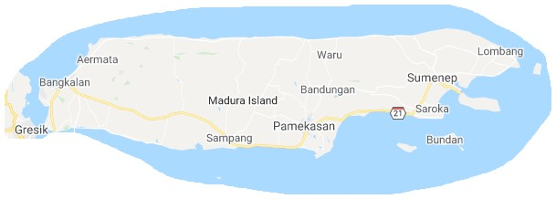
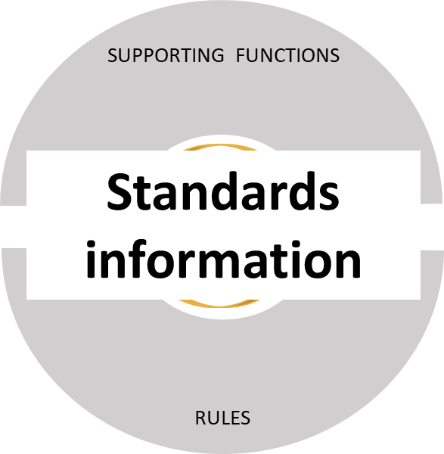
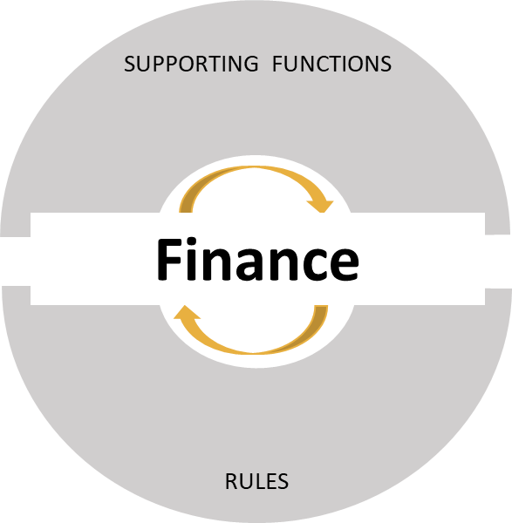
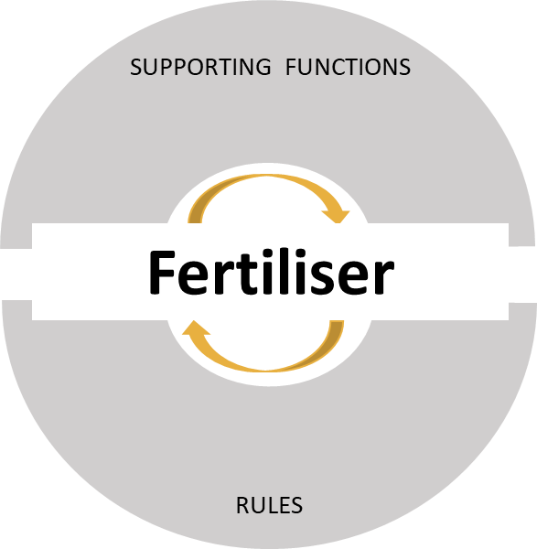
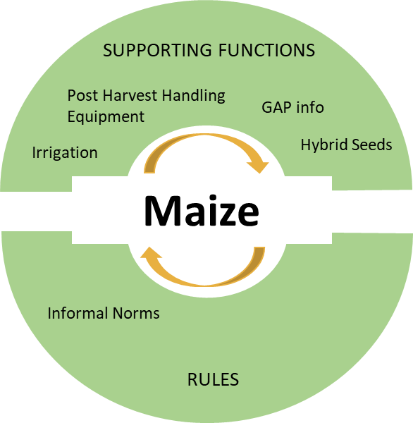
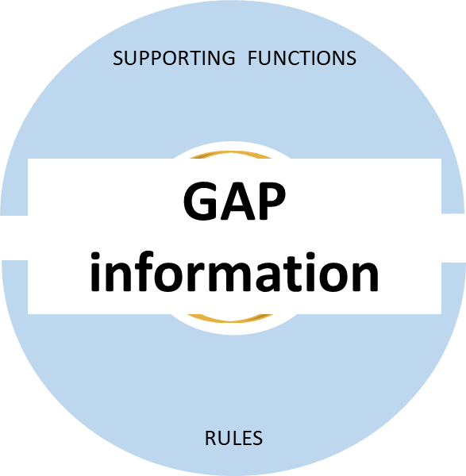
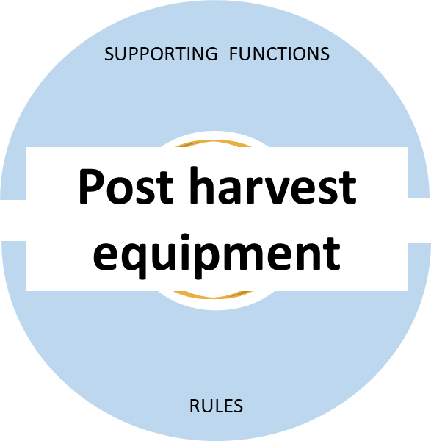
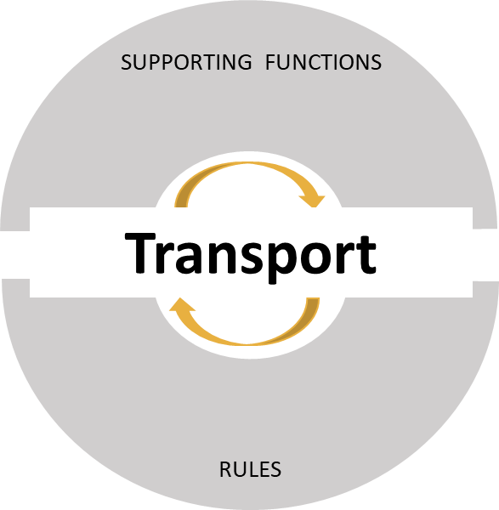
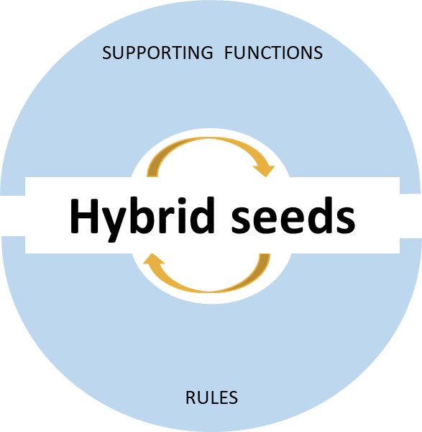
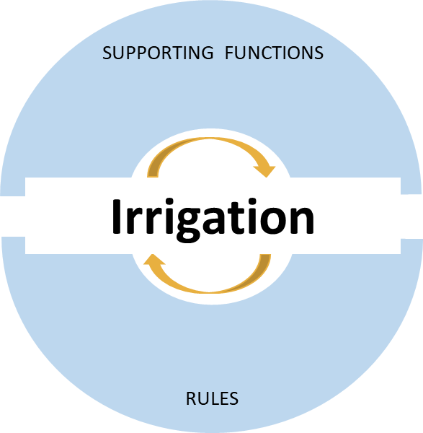
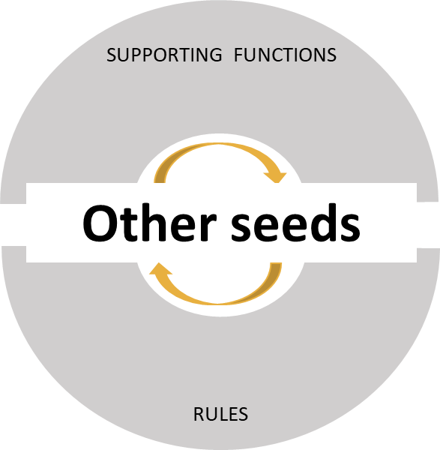
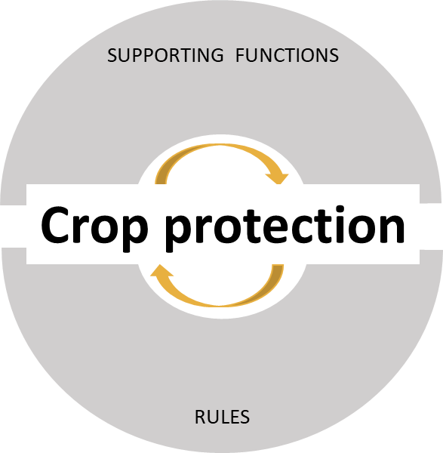
Maize sold by smallholder farmers on Madura Island
Impact
Google Maps
Notes:
Systems are complex and interlinked and dynamic, so how does a program do this in practice?
That's true - and it is one of the reasons so many programs find dealing with system change challenging…if we try to look at it all at once, it can seem overwhelming and hard to grasp.
In practice we tend to deal with this by breaking systems down into parts which makes them easier to handle. That can be really useful, as long as we remember that we also need to look at systems as a whole and think about the effect of all the different parts interacting and working together.
This all starts with delineating boundaries. A 'system' is determined by what the programme decides is relevant to its goals and objectives, and by what it can realistically achieve in the time and with the resources it has got available.
[enter slide]
To take an example you might see an opportunity for smallholder farmers to increase their incomes if they could start producing more, and better quality, maize. This is based on a real example from the PRISMA programme in Indonesia, but we’ve adapted it.
If that was the case, your main system would be maize, and you would want to look at all the things that affect how much smallholder farmers are able to make off selling maize. This might lead you to identify several ‘supporting systems’ - other systems that are somehow negatively affecting the way the main system works – and how well it works – for our target group. In this case, let’s say we identified post-harvest equipment, irrigation, hybrid seeds and information about Good Agricultural Practices – or GAP. So we draw our boundaries to include these systems.
Of course, this means you are excluding a lot of other supporting systems. It’s not that they don’t also affect how well the maize system works. They might represent constraints too – but you have to draw boundaries somewhere, and in this case we have determined that they are not as important.
Remember you’re also excluding other systems the farmers might be involved in – such as other crops they grow. And you’re drawing even more specific boundaries too - in this case, we’re going to say its maize produced and sold by smallholder farmers on Madura Island.
Delineating system boundaries is a really critical foundation for designing strategy and, later, for assessing system change – because system change is relative. Boundaries may change over time as the programme learns.
Now we’ve got a better sense of what we mean by “the system,” we can come up with a system strategy for how things could work differently to improve the main system.
We’ll also come up with a portfolio of interventions to introduce changes to our targeted supporting systems, and intervention plans for each of them.

Slide 4
Main system: | Maize that is, or could be, produced and sold by smallholder farmers on Madura Island.
Indicators | Starting system state | Plan 2020-2025 | Desired system state
Main system: Maize
Volume of maize sold from target area | 395,000 tonnes | The program will first focus on increasing the supply of hybrid seeds and embedded information on good agricultural practices (GAP) for small farmers from private and public actors. The resulting increase in yields and interest in transacting with small farmers is expected to drive changes in other supporting systems and encourage small farmers to become more commercial. Once farmers start to increase yields, ………… etc. | 500,000 tonnes
Farmers’ perceptions of maize crop | Mainly subsistence |  | Both subsistence and cash crop
Etc. | Etc. |  | Etc.
Supporting system 1: Hybrid maize seed
Volume of hybrid seeds sold on Madura Island | 150,000 Kg | The program will work to 1) increase private sector investment in the commercial distribution of hybrid seeds to small farmers with embedded information on GAP, and 2) improve public-private coordination in hybrid seed distribution. These two changes are interdependent, and changes in …………………etc. | 375,000 Kg
Number of companies selling and advising on hybrid maize seeds | 1 |  | 4
Etc. | Etc. |  | Etc.
Supporting system 2, etc.

Slide 5
Helicopter lens
Impact
Maize
GAP Information
Post Harvest Equipment
Irrigation
Hybrid Seeds
Intervention lens
Notes:
Adam – first click
Aly – 2nd click
We can animate differently if we want to show the maize system and impact with the intervention lens.

Slide 6
1 What do we aim to assess? Are maize farmers shifting from subsistence to commercial maize farming?
2 What do we need to know? | 3 Who has information about this? | 4 What type of information do they have? | 5 How to collect this information? | 6 When and how often to collect this information?
How do maize farmers perceive maize farming? | Smallholder farmers (wide representation across system) Traders District agricultural officers | Perceptions and opinions Information on volume of maize traded | Poll farmers at farmers’ markets Interview traders by phone Interview district officers at annual events. | End of season
Are volumes of maize traded increasing across the whole system?
Notes:
One click in script

Slide 7
Review and revise
Assess system changes with intervention lens
Diagnose systems
Develop system strategy
Develop intervention plans
Implement interventions
Analyse system changes and program contribution
Report
Assess system changes with helicopter lens
Review and revise
Notes:
Annimate to make relevant bits stand out

Slide 8

Graduates are employed
and earn higher incomes
Vocational schools develop and offer apprenticeships
Students are better informed and learn appropriate skills
Vocational schools apply effective training methods
Vocational schools offer demand driven training
Business give insights on the labour market needs
More youngsters are better informed and enroll in schools
Vocational schools improve marketing processes
Vocational schools and local businesses join forces
Vocational schools improve their management
Vocational schools improve and offer enabling facilities

Slide 9
Main system: | Vocational Education and Training in Albania
Indicators | Starting system state | Plan 2016-2023 | Desired system state
Main system: Vocational Education and Training
Number of graduates finding gainful employment | Av time to employment is 9 months and 30% of graduates are employed in the sector they were trained for | S4J will first support 7 VET providers in 5 regions to test and roll out new ways of working all aimed at helping schools to ………….The program will assist schools to develop a unit to implement the new ways of working …….. S4J will then offer additional support to …… S4J will also lobby with national stakeholders to create flexibility and conditions for schools, ………….………… etc. | Av time to employment is 3 months and 60% of graduates are employed in the sector they were trained for
Reputation of VET among the private sector | 30% of the companies recruit graduates because they are a suitable workforce |  | 60% of the companies recruit graduates because they are a suitable workforce
Etc. | Etc. |  | Etc.
Supporting system 1: Curricula
Curricula development process | Curricula are revised by national VET agencies in isolation from national labour markets | S4J will …………..Searching for companies within specific sectors in the regions to cooperate with ……..S4J will lobby the national agencies to allow flexibility and create conditions for schools to develop curricula that……. | The private sector supports VET schools to develop and revise curricula to meet the needs of local labour markets
Supporting system 2, etc.

Slide 10
1 What do we aim to assess? Have school-leavers changed their perception of VET?
2 What do we need to know? | 3 Who has information about this? | 4 What type of information do they have? | 5 How to collect this information? | 6 When and how often to collect this information?
How do school-leavers perceive VET ? | School leavers Parents College teachers | Perceptions and opinions | On-line survey using social media (Facebook) Polls at college parent meetings Online survey using panel of teachers | Annually in May
Are the enrolment rates changing? | National VET agency Individual VET schools | Enrolment and early drop-out rates | MoU VET Agency to provide for all schools MoU to provide access to MIS of supported schools | Annually in September and January

Slide 11
A pragmatic approach to assessing system change
Date: 30th April 2020
Thank you for joining the webinar
Please fill in our quick online survey – the link is in the Chat box
A recording of this webinar will be available shortly if you visit our Webinars page at www.beamexchange.org/community/webinar/

